Slide 1

Animation
Notes:
Show bouncing Karel

Slide 2
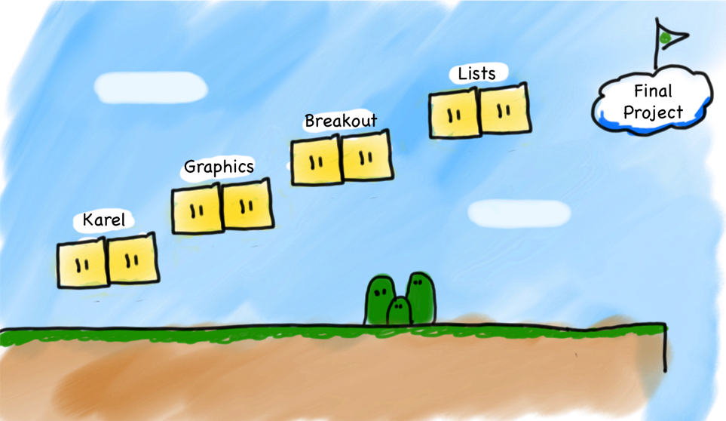
Our story so far…
Notes:
Review what we have learned in class so far

Slide 3
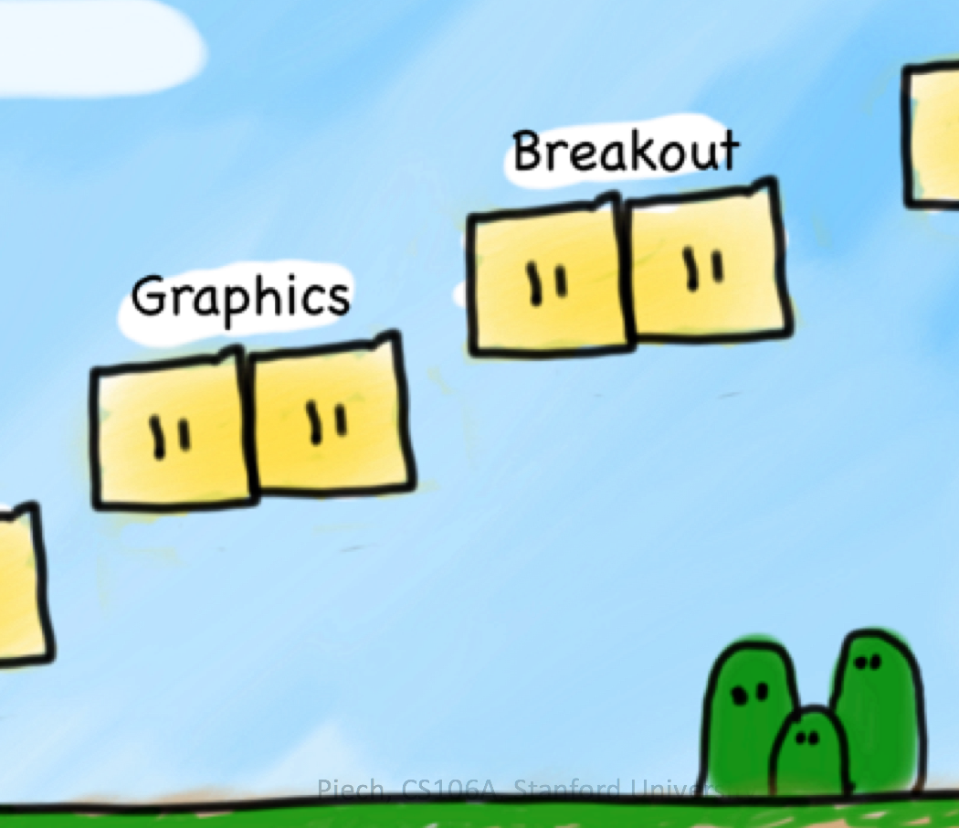
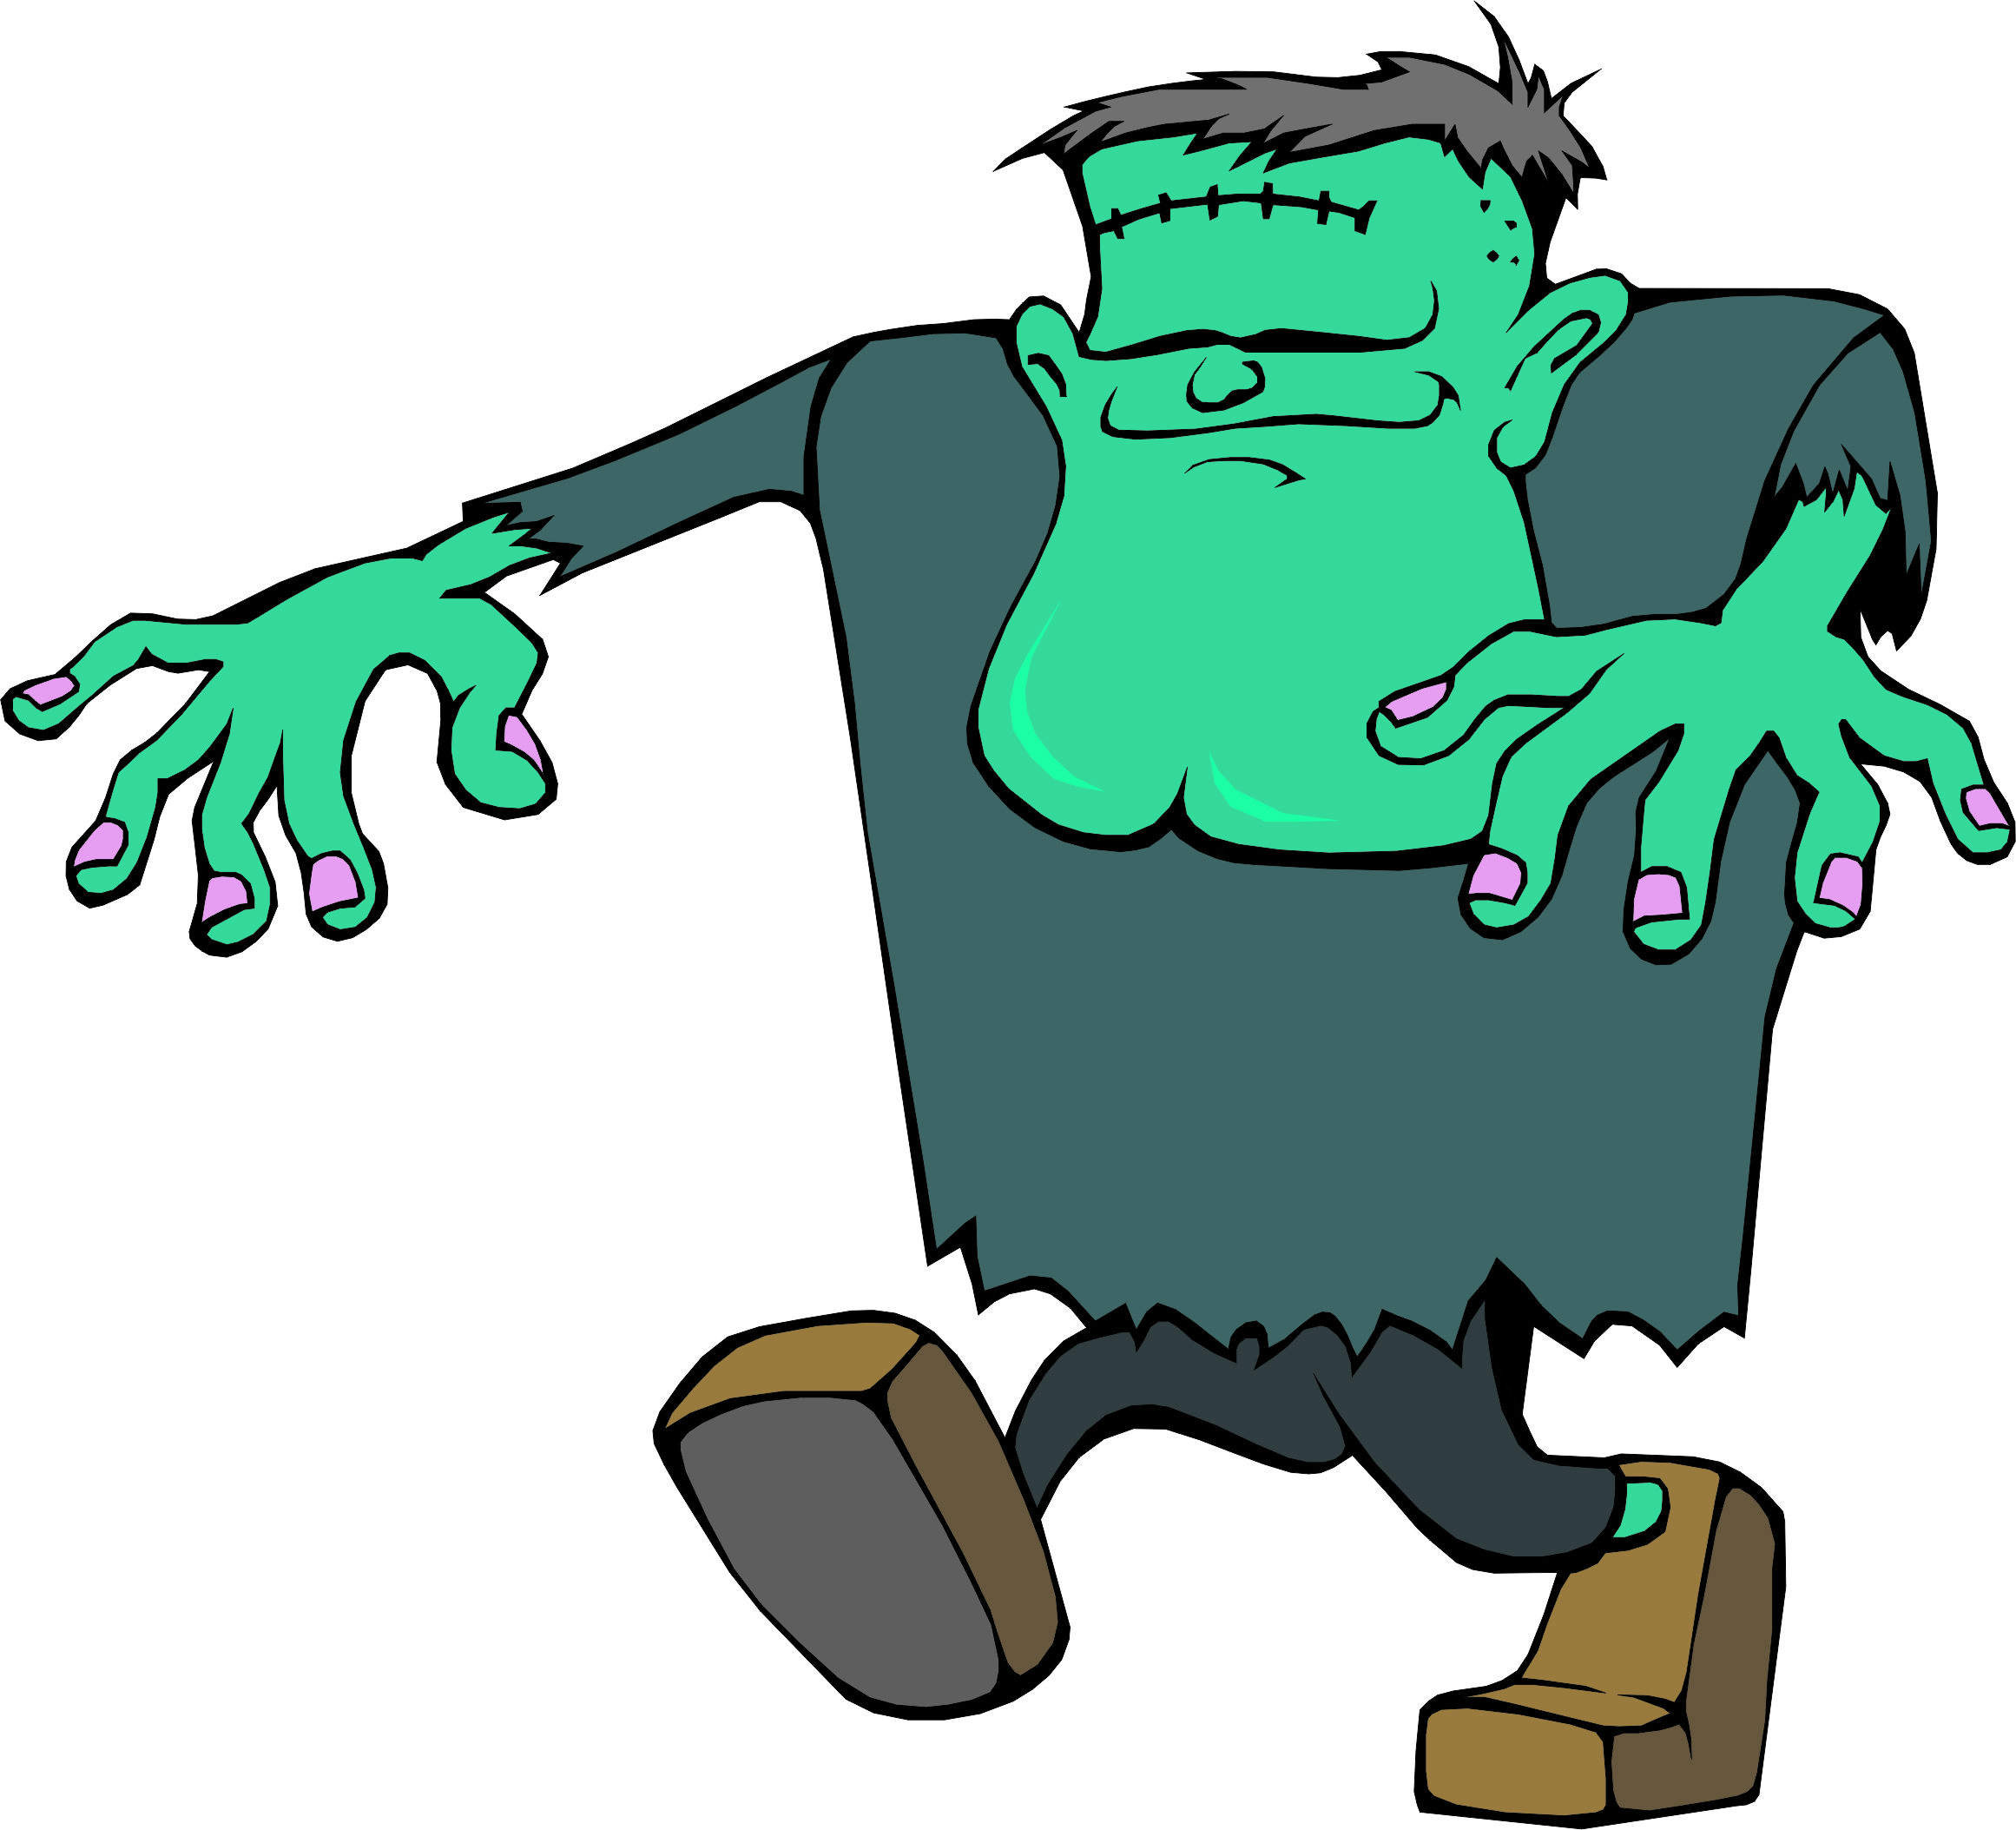
Our story so far…
Notes:
The jump from graphics to breakout.
Its alive!

Slide 4
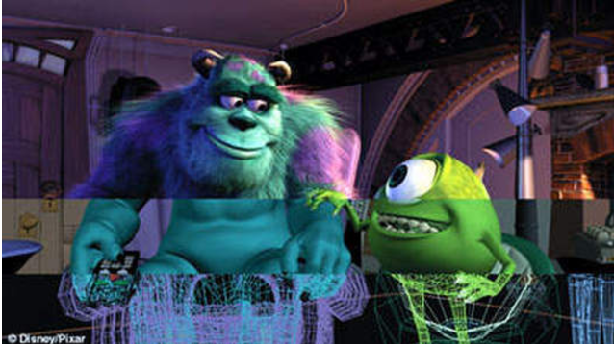
Learning Goals
Write animated programs
Center an object
Notes:
Appeal to something that is more real

Slide 5
You will be able to write Bouncing Ball

Slide 6

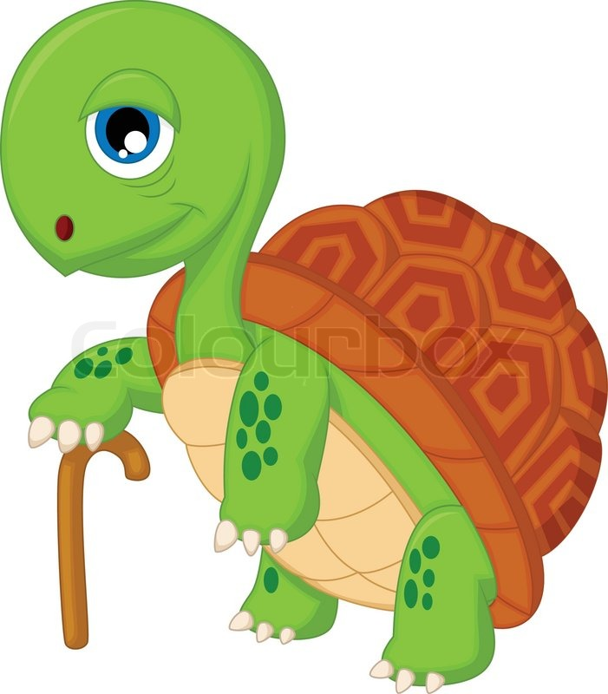
Learning Goals For Me
Speak slower

Slide 7
But First!
private void run() {
int x = 6 – 4 + 7 * 3;
println(x);
int y = (6 + 4 + 7) * 3;
println(y);
int z = 6 / 2 * 3;
println(z);
}
Notes:
23
27
9.0

Slide 8
Move GRect
Notes:
Show video!

Slide 9
Animation Loop
private void run() {
// setup
while(true) {
// update world
// pause
pause(DELAY);
}
}

Slide 10
Animation Loop
private void run() {
// setup
while(true) {
// update world
// pause
pause(DELAY);
}
}
Make all the variables you need. Add graphics to the screen.

Slide 11
Animation Loop
private void run() {
// setup
while(true) {
// update world
// pause
pause(DELAY);
}
}
The animation loop is a repetition of heartbeats

Slide 12
Animation Loop
private void run() {
// setup
while(true) {
// update world
// pause
pause(DELAY);
}
}
Each heart-beat, update the world forward one frame

Slide 13
Animation Loop
private void run() {
// setup
while(true) {
// update world
// pause
pause(DELAY);
}
}
If you don’t pause, humans won’t be able to see it

Slide 14

Move To Center
private void run() {
// setup
GRect r = new Grect(0, 250, 100, 100);
r.setFilled(true);
add(r);
while(true) {
// update world
r.move(1, 0);
// pause
pause(DELAY);
}
}

Slide 15
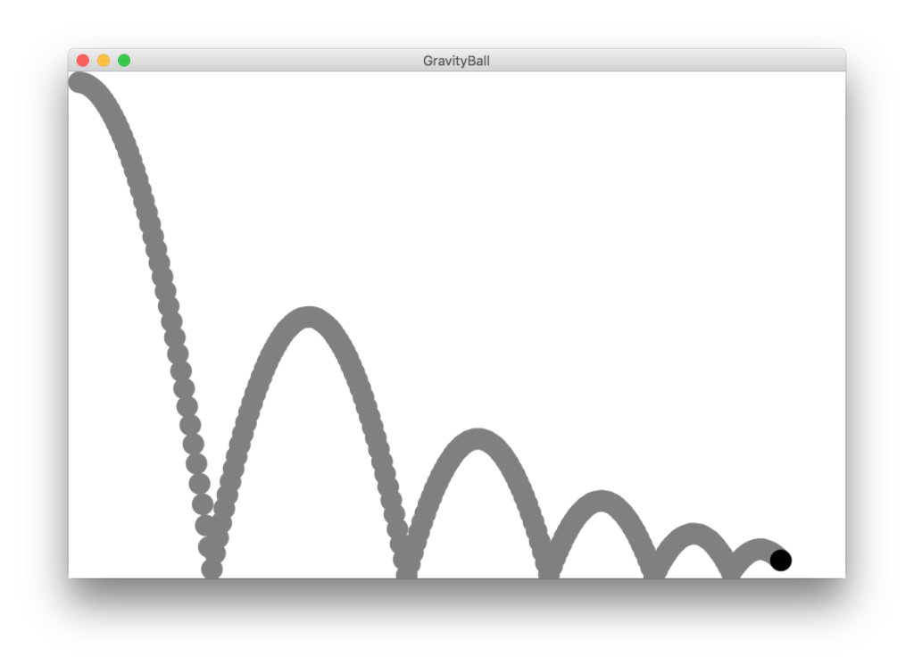
Gravity Ball

Slide 16
Gravity Ball
First heartbeat
Velocity: how much the ball position
changes each heartbeat

Slide 17
Gravity Ball
First heartbeat
vx
vy
The GOval move method takes in
a change in x and a change in y
Notes:
How does vx change?

Slide 18
Gravity Ball
Second heartbeat
vx
vy

Slide 19
Gravity Ball
Third heartbeat
vx
vy
Notes:
How does vy change?

Slide 20
Gravity Ball
What happens when we hit a wall?

Slide 21
Gravity Ball
We have this velocity
vx
vy

Slide 22
Gravity Ball
Our new velocity
vx
vy
vy = vy * -DAMPING;
Notes:
vy = vy * -DAMPING;

Slide 23
Gravity Ball
Seventh Heartbeat
vy
vx
vy = vy * -DAMPING;
Notes:
vy = vy * -DAMPING;

Slide 24

Questions?

Slide 25
Gravity Ball

Slide 26
A Sticky Situation
This is our new velocity
The ball is above the bottom so we reverse its vy
The ball is bellow the bottom so we reverse its vy

Slide 27

Centering

Slide 28

By Chris

Slide 29
Once upon a time…

Slide 30
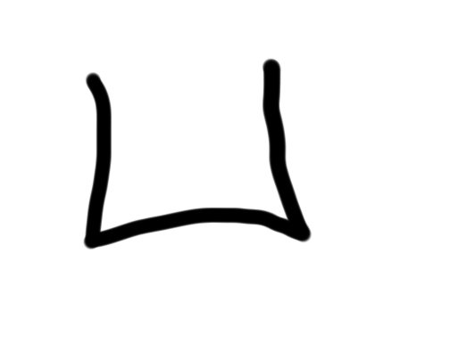
x was looking for love…
int x = 5;
if(lookingForLove()) {
int y = 5;
}
println(x + y);
5
x

Slide 31
x was looking for love…
int x = 5;
if(lookingForLove()) {
int y = 5;
}
println(x + y);
5
x

Slide 32
x was looking for love…
x was definitely
looking for love
int x = 5;
if(lookingForLove()) {
int y = 5;
}
println(x + y);
5
x

Slide 33
And met y
int x = 5;
if(lookingForLove()) {
int y = 5;
}
println(x + y);
5
5
x
y

Slide 34
And met y
int x = 5;
if(lookingForLove()) {
int y = 5;
}
println(x + y);
5
5
Hi, I’m y
x
y

Slide 35
“Wow!”

Slide 36
And met y
int x = 5;
if(lookingForLove()) {
int y = 5;
}
println(x + y);
Wow
5
5
x
y

Slide 37
And met y
int x = 5;
if(lookingForLove()) {
int y = 5;
}
println(x + y);
5
5
We have so much in common
x
y

Slide 38
And met y
int x = 5;
if(lookingForLove()) {
int y = 5;
}
println(x + y);
5
5
We both have value 5!
x
y

Slide 39
And met y
int x = 5;
if(lookingForLove()) {
int y = 5;
}
println(x + y);
5
5
Maybe one day we can…
x
y

Slide 40
And met y
int x = 5;
if(lookingForLove()) {
int y = 5;
}
println(x + y);
5
5
println together?
x
y

Slide 41
They got along
int x = 5;
if(lookingForLove()) {
int y = 5;
}
println(x + y);
5
5
x
y

Slide 42
It was a beautiful match…

Slide 43
But then tragedy struck.

Slide 44
Tragedy Struck
int x = 5;
if(lookingForLove()) {
int y = 5;
}
println(x + y);
5
5
x
y

Slide 45
Tragedy Struck
int x = 5;
if(lookingForLove()) {
int y = 5;
}
println(x + y);
5
5
x
y

Slide 46
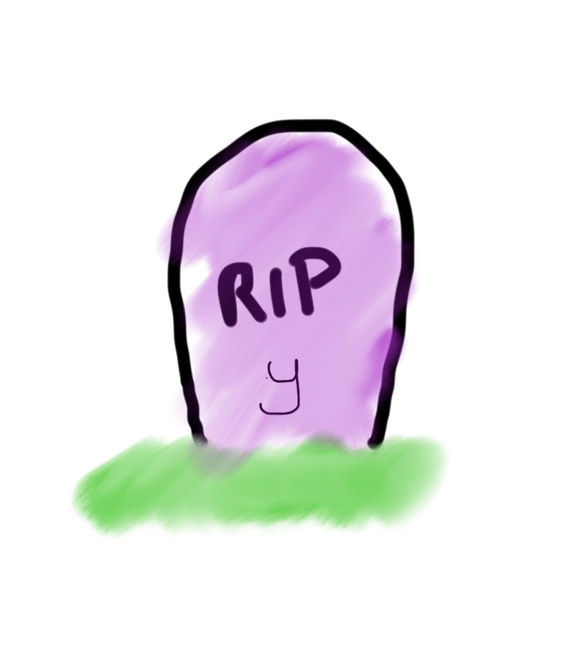
Tragedy Struck
int x = 5;
if(lookingForLove()) {
int y = 5;
}
println(x + y);
5
x

Slide 47
Noooooooooooooooo!

Slide 48
You see…

Slide 49
When a program exits the code block…
int x = 5;
if(lookingForLove()) {
int y = 5;
}
println(x + y);
5
x

Slide 50
Where a variable was declared…
int x = 5;
if(lookingForLove()) {
int y = 5;
}
println(x + y);
5
x

Slide 51
It gets deleted from memory!
int x = 5;
if(lookingForLove()) {
int y = 5;
}
println(x + y);
5
x

Slide 52
Since y was declared inside the if
int x = 5;
if(lookingForLove()) {
int y = 5;
}
println(x + y);
5
x

Slide 53
It gets deleted from memory here
int x = 5;
if(lookingForLove()) {
int y = 5;
}
println(x + y);
5
x

Slide 54
And doesn’t exist here.
int x = 5;
if(lookingForLove()) {
int y = 5;
}
println(x + y);
5
x

Slide 55
And doesn’t exist here.
Error. Undefined variable y.
int x = 5;
if(lookingForLove()) {
int y = 5;
}
println(x + y);
5
x

Slide 56
The End

Slide 57
Or is it?

Slide 58
Variables have a lifetime
public void run(){
double v = 8;
if(condition){
v = 4;
… some code
}
… some other code
}

Slide 59
Variables have a lifetime
public void run(){
double v = 8;
if(condition){
v = 4;
… some code
}
… some other code
}

Slide 60
Come to existence when declared
public void run(){
double v = 8;
if(condition){
v = 4;
… some code
}
… some other code
}
Comes to life here
8
v

Slide 61
Live Until End of Code-Block
public void run(){
double v = 8;
if(condition){
v = 4;
… some code
}
… some other code
}
This is the inner most
code block in which it was
declared….
4
v

Slide 62
Variables have a lifetime
public void run(){
double v = 8;
if(condition){
v = 4;
… some code
}
… some other code
}
Still alive here…
4
v

Slide 63
Live Until End of Code-Block
public void run(){
double v = 8;
if(condition){
v = 4;
… some code
}
… some other code
}
4
v
It dies here (at the end of its code block)

Slide 64

Live Until End of Code-Block
public void run(){
double v = 8;
if(condition){
v = 4;
… some code
}
… some other code
}
It dies here (at the end of its code block)

Slide 65
Chapter 2

Slide 66
The programmer fixed her bug

Slide 67
x was looking for love…
int x = 5;
if(lookingForLove()) {
int y = 5;
println(x + y);
}
5
x

Slide 68
x was looking for love…
x was definitely
looking for love
int x = 5;
if(lookingForLove()) {
int y = 5;
println(x + y);
}
5
x

Slide 69
x met y
int x = 5;
if(lookingForLove()) {
int y = 5;
println(x + y);
}
5
5
x
y

Slide 70
Since they were both in scope…
int x = 5;
if(lookingForLove()) {
int y = 5;
println(x + y);
}
5
5
x
y

Slide 71
The story had a happy ending!

